Slide 1
ANN Building Blocks Feed Forward
Course Code: CSC 4254
Course Title: Computer Vision & Pattern Recognition
Dept. of Computer Science
Faculty of Science and Technology
Lecture No: | 5 | Week No: | 3 | Semester:
Lecturer:

Slide 2
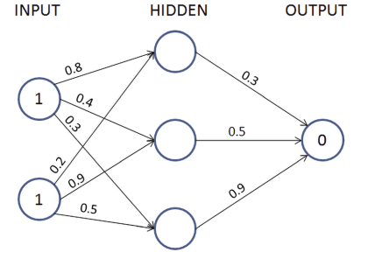
Feed Forward Propagation
Calculate the weighted sum for each neuron and pass through an activation function to trigger the neuron.
The value of each neuron of hidden layer before activation is calculated as:

Slide 3
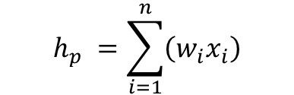
Feed Forward Propagation
Calculate the weighted sum for each neuron and pass through an activation function to trigger the neuron. The value of each neuron of hidden layer before activation is given below:
$$h_{p} =\sum_{i=1}^{n}{\left(w_{i}x_{i}\right)}$$

Slide 4
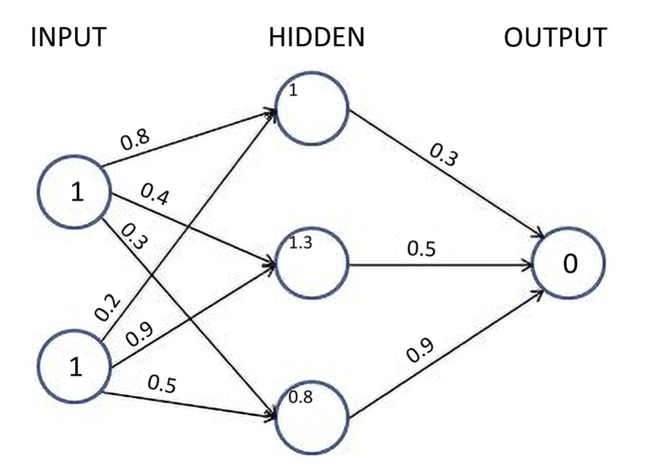
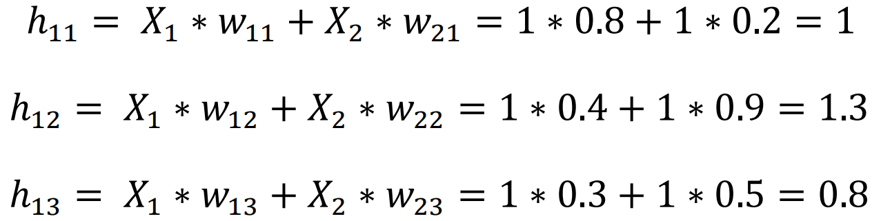
Feed Forward Propagation
Calculate the weighted sum for each neuron and pass through an activation function to trigger the neuron. The value of each neuron of hidden layer before activation is given below:

Slide 5
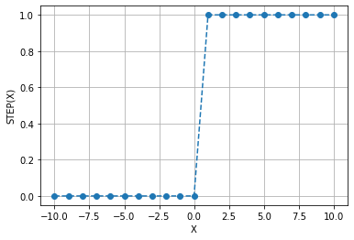
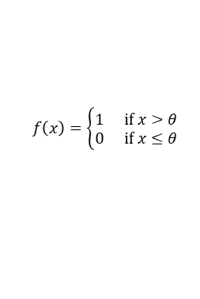
Different Types Activation Functions
An activation function allows to confirm the output to some desired range. In other words, it can be asserted that a neuron should fire or not - in terms of the idea of a brain i.e. what happens when the output comes out from the neuron.
Step function: The step or threshold activation function is a simple activation function that outputs a value of 1.0 for incoming values of (threshold value) or higher and 0 for all other values. Step functions, also known as threshold functions, only return 1 (true) for values that are above the specified threshold.
$$f\left(x\right)=\left\{\begin{matrix}1 & if x>θ \\ 0 & if x≤θ\end{matrix}\right.$$

Slide 6
Different Types Activation Functions
An activation function allows to confirm the output to some desired range. In other words, it can be asserted that a neuron should fire or not - in terms of the idea of a brain i.e. what happens when the output comes out from the neuron.
Step function: The step or threshold activation function is a simple activation function that outputs a value of 1.0 for incoming values of (threshold value) or higher and 0 for all other values. Step functions, also known as threshold functions, only return 1 (true) for values that are above the specified threshold.
$$f\left(x\right)=\left\{\begin{matrix}1 & if x>θ \\ 0 & if x≤θ\end{matrix}\right.$$
Problems:
Output is only 0 or 1
No probability or confidence information
The step function has a sharp jump

Slide 7
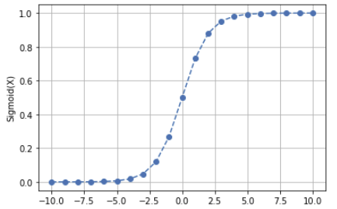

Different Types Activation Functions
Sigmoid: it takes a real-valued number and squashes it into range between 0 and 1. Therefore, it is especially used for models where we have to predict the probability as an output. Since probability of anything exists only between the range of 0 and 1, sigmoid is the good choice.
In particular, large negative numbers become 0 and large positive numbers become 1. The sigmoid function has seen frequent use historically.
$$σ\left(x\right)=\frac{1}{1+e^{\left(−x\right)}}$$

Slide 8
Different Types Activation Functions
Sigmoid: it takes a real-valued number and squashes it into range between 0 and 1. Therefore, it is especially used for models where we have to predict the probability as an output. Since probability of anything exists only between the range of 0 and 1, sigmoid is the good choice.
In particular, large negative numbers become 0 and large positive numbers become 1. The sigmoid function has seen frequent use historically.
$$σ\left(x\right)=\frac{1}{1+e^{\left(−x\right)}}$$
Problems:
For very high or very low values of X, there is almost no change to the prediction that can result in the network refusing to learn further,or being too slow to reach an accurate prediction.
Outputs not zero centered.
Computationally expensive

Slide 9
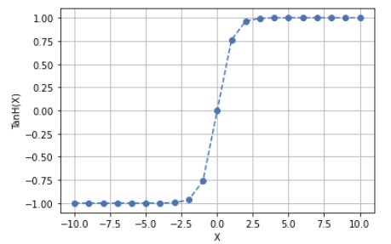

Different Types Activation Functions
Tanh: The hyperbolic tangent function is also a prevalent activation function for neural networks that must output values in the range between -1 and 1. This activation function is simply the hyperbolic tangent (tanh) function, as shown in the following equation:
$$\begin{matrix}tanh\left(x\right) & =\frac{e^{x}−e^{−x}}{e^{x}+e^{−x}} \\ & =\frac{e^{2x}−1}{e^{2x}+1}\end{matrix}$$

Slide 10
Different Types Activation Functions
Tanh: The hyperbolic tangent function is also a prevalent activation function for neural networks that must output values in the range between -1 and 1. This activation function is simply the hyperbolic tangent (tanh) function, as shown in the following equation:
$$\begin{matrix}tanh\left(x\right) & =\frac{e^{x}−e^{−x}}{e^{x}+e^{−x}} \\ & =\frac{e^{2x}−1}{e^{2x}+1}\end{matrix}$$
Problems:
As for Sigmoid, Tanh is highly compute-intensive and suffers from saturation problem and thus vanishing gradient.
When the neuron reaches the minimum or maximum value of its range, that respectively correspond to -1 and 1, its derivative is equal to 0.

Slide 11
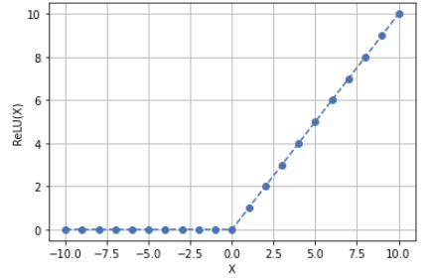
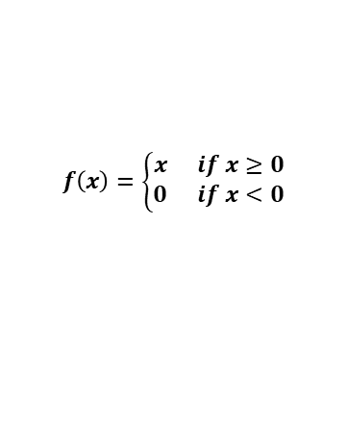
Different Types Activation Functions
Rectified Linear Units (ReLU): The Rectified Linear Unit has become very popular in the last few years.Compared to tanh/sigmoid neurons that involve expensive operations (exponentials, etc.), the ReLU can be implemented by simply thresholding a matrix of activations at zero.
$$f\left(x\right)=\left\{\begin{matrix}x & if x≥0 \\ 0 & if x<0\end{matrix}\right.$$

Slide 12
Different Types Activation Functions
Rectified Linear Units (ReLU): The Rectified Linear Unit has become very popular in the last few years.Compared to tanh/sigmoid neurons that involve expensive operations (exponentials, etc.), the ReLU can be implemented by simply thresholding a matrix of activations at zero.
$$f\left(x\right)=\left\{\begin{matrix}x & if x≥0 \\ 0 & if x<0\end{matrix}\right.$$
Problems:
All the negative values become zero immediately which decreases the ability of the model to fit or train from the data properly. That means any negative input given to the ReLU activation function turns the value into zero immediately in the graph, which in turns affects the resulting graph by not mapping the negative values appropriately.

Slide 13
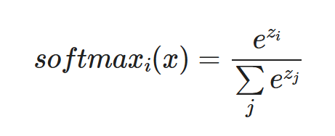
Different Types Activation Functions
Softmax: Usually, the softmax function is used in the output layer of a neural network. Classification neural networks typically employ the softmax function. The neuron that has the highest value claims the input as a member of its class. Because it is a preferable method, the softmax activation function forces the output of the neural network to represent the probability that the input falls into each of the classes. Without the softmax, the neuron's outputs are simply numeric values, with the highest indicating the winning class.
Here, the Z represents the values from the neurons of the output layer. The exponential acts as the non-linear function. Later these values are divided by the sum of exponential values in order to normalize and then convert them into probabilities.
Note that, when the number of classes is two, it becomes the same as the sigmoid activation function. In other words, sigmoid is simply a variant of the Softmax function.

Slide 14
Recall of Feed Forward Propagation
Calculate the weighted sum for each neuron and pass through an activation function to trigger the neuron. The value of each neuron of hidden layer before activation is given below:

Slide 15
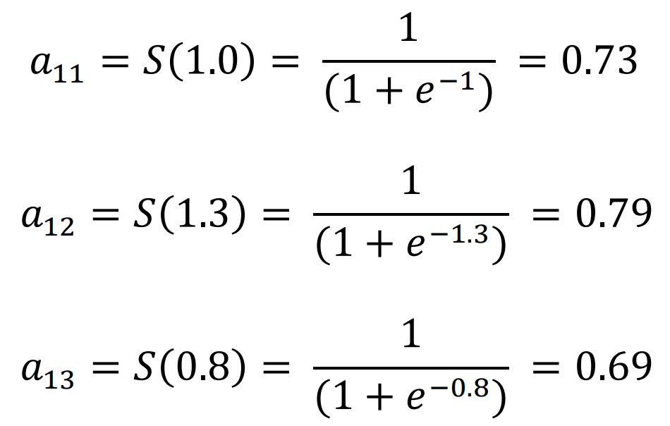
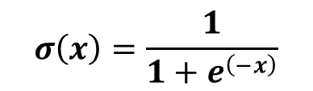
Apply Sigmoid Activation
$$σ\left(x\right)=\frac{1}{1+e^{\left(−x\right)}}$$

Slide 16
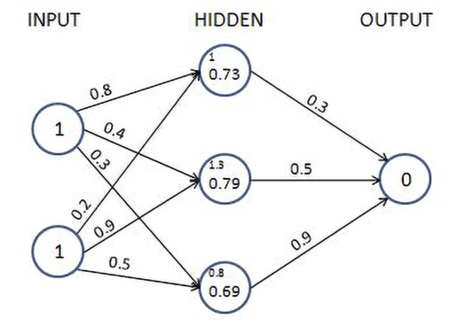
Apply Sigmoid Activation
$$σ\left(x\right)=\frac{1}{1+e^{\left(−x\right)}}$$

Slide 17
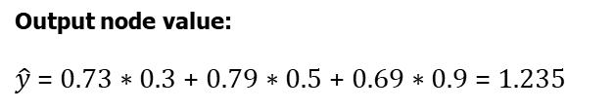
Apply Sigmoid Activation
$$σ\left(x\right)=\frac{1}{1+e^{\left(−x\right)}}$$
Output node value:
$\hat{y}$= 0.73 ∗ 0.3 + 0.79 ∗ 0.5 + 0.69 ∗ 0.9 = 1.235

Slide 18
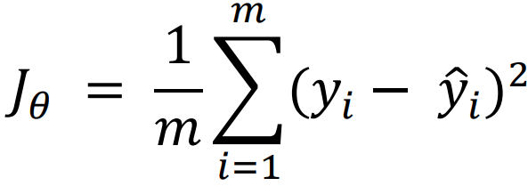
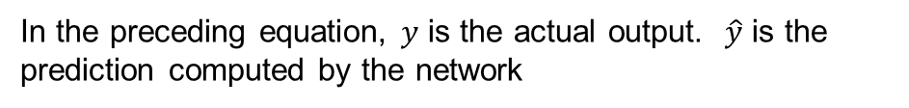
Loss Values
Loss values (alternatively called cost functions) are the values that we optimize for in a neural network. Goal of training → Minimize the loss
Loss Calculation for Continuous variable:
Typically when the loss value is continuous its calculated as the mean square of the difference in actual and predicted value also known as MSE
In the preceding equation, 𝑦 is the actual output. $\hat{y}$ is the prediction computed by the network
Loss Calculation for Categorical value: We will discuss in prediction of categorical data prediction.

Slide 19

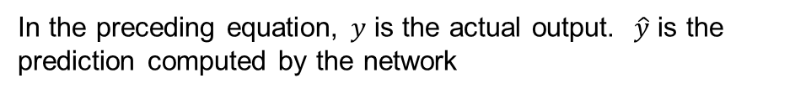
Loss Values
Loss values (alternatively called cost functions) are the values that we optimize for in a neural network. Goal of training → Minimize the loss
Loss Calculation for Continuous variable:
Typically when the loss value is continuous its calculated as the mean square of the difference in actual and predicted value also known as MSE
In the preceding equation, 𝑦 is the actual output. $\hat{y}$ is the prediction computed by the network
Loss Calculation for Categorical value: We will discuss in prediction of categorical data prediction.
For our case:

Slide 20
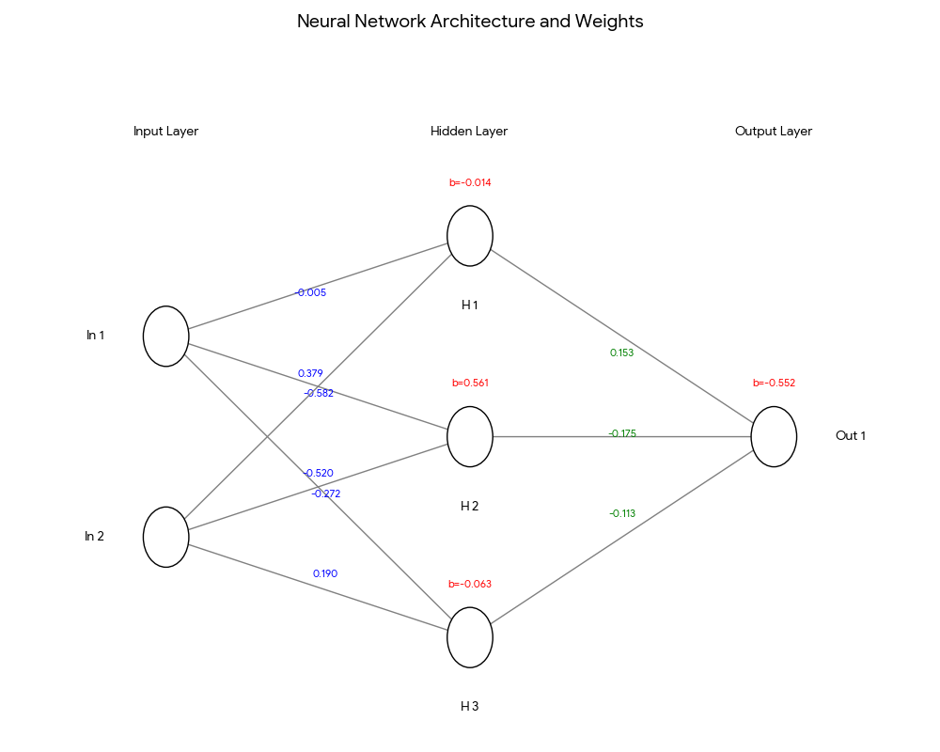
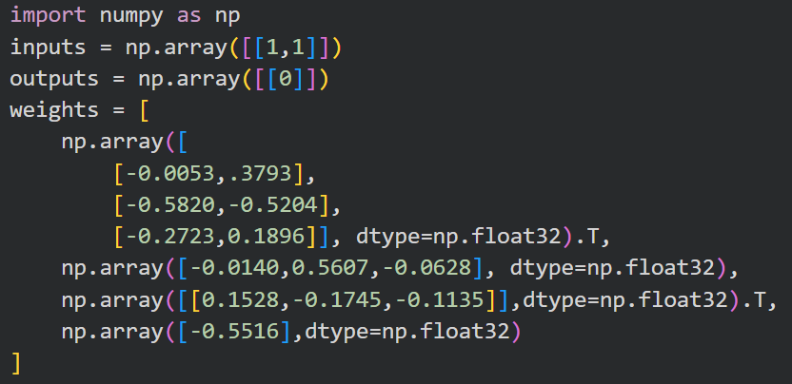
Implementation of Feed Forward and Loss

Slide 21
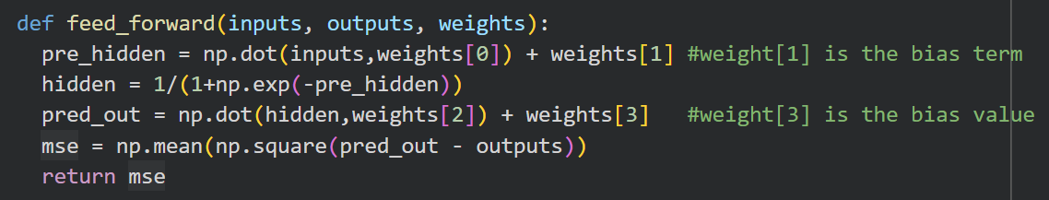
Implementation of Feed Forward and Loss

